Slide 1
Lesson 3 Text & Objects Making text areas

Slide 2
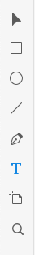
Adding text
In Adobe XD you can add text with two options:
One line text
Text area with multiple lines
To start adding text choose text tool
With text tool active click on top of design page to create one line text
Text tool

Slide 3
Adding text
Once you have clicked on design page enter some text like: ”FindMeCar”
Once you have typed text, use ”Select tool” to move text to center of the screen.
You can see while moving object that Adode XD helps you to place objects on some keyp points (like center of screen)

Slide 4
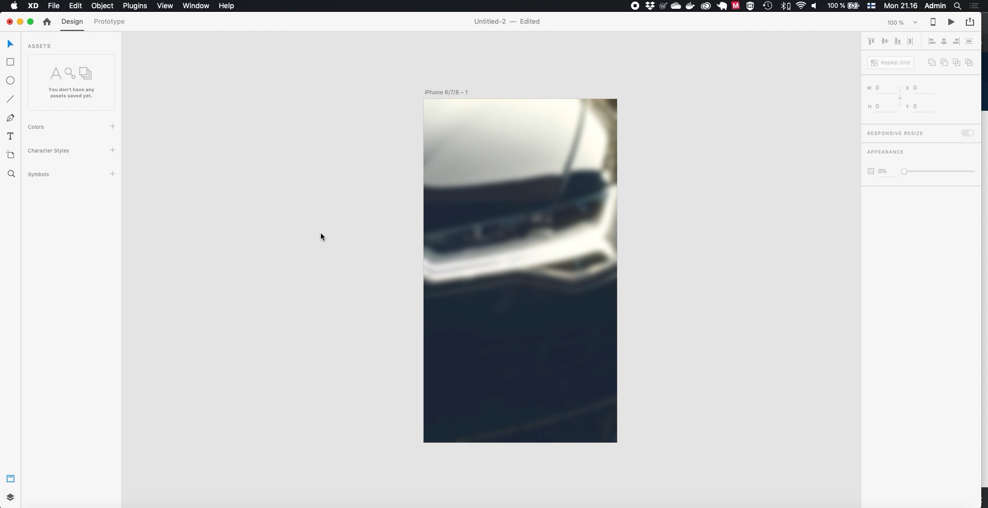

Slide 5
Object properties

Slide 6
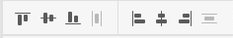
Alignment properties
On the right pane you can access object properties.
On top of the pane first properties affect to alignment
Alignment commands can be applied to any selected object or object groups
Align top
Align bottom
Align left
Align right
Center vertically
Center horizontically

Slide 7
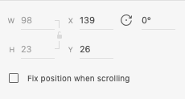
Position and rotation
Next property set is object position, size and rotation
On text objects its not possible to change width / height, but you can manually change position (X/Y) and its rotation
Width / height of object
Rotation of object
Position of object

Slide 8
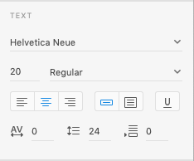
Text properties
On text objects, font size and other properties can be changed
Also character spacing, row height are adjustable.
Choose now ”Open Sans” as our font type, make it BOLD and size of 60

Slide 9


Slide 10
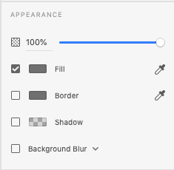
Appearance
Last properties that you can change are related to Appearance
First setting relates to opacity of objects.
Second on is fill color, or in text actual color of text. By clicking color on left of Fill text you can choose color
Or you can use eyedropper tool to select color from anywhere of screen
Third one is border color of object
Fourth one add shadow to object
And last one can be used to blur design behind selected object

Slide 11
Appearance
Lets use eyedropper tool to select color for our text, we can pick color from our background imge
Also lets add some shadow to text
And finally as text seems too large, we make size of 45

Slide 12
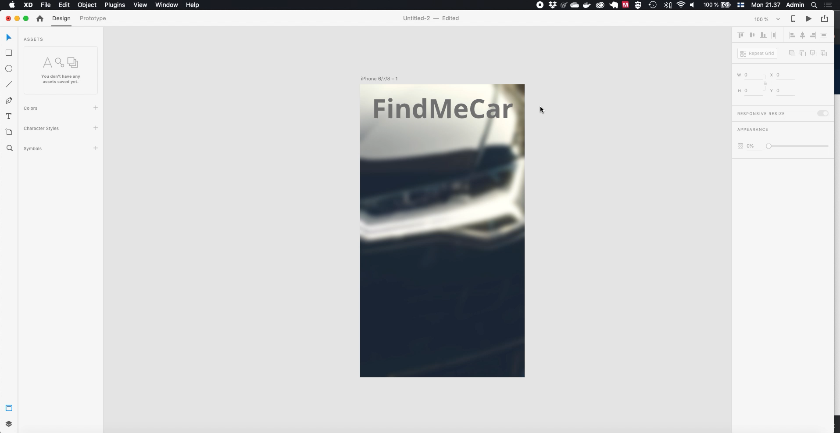

Slide 13
Making text area
Now we can add text area to below of our title text.
This can be made by choosing text tool and then pressing and dragging wanted area on our page.
Once area is ready, type some information to user
Then modify properties of text are by selecting it and choosing:
Font size 20
Font color white
Font type regular

Slide 14
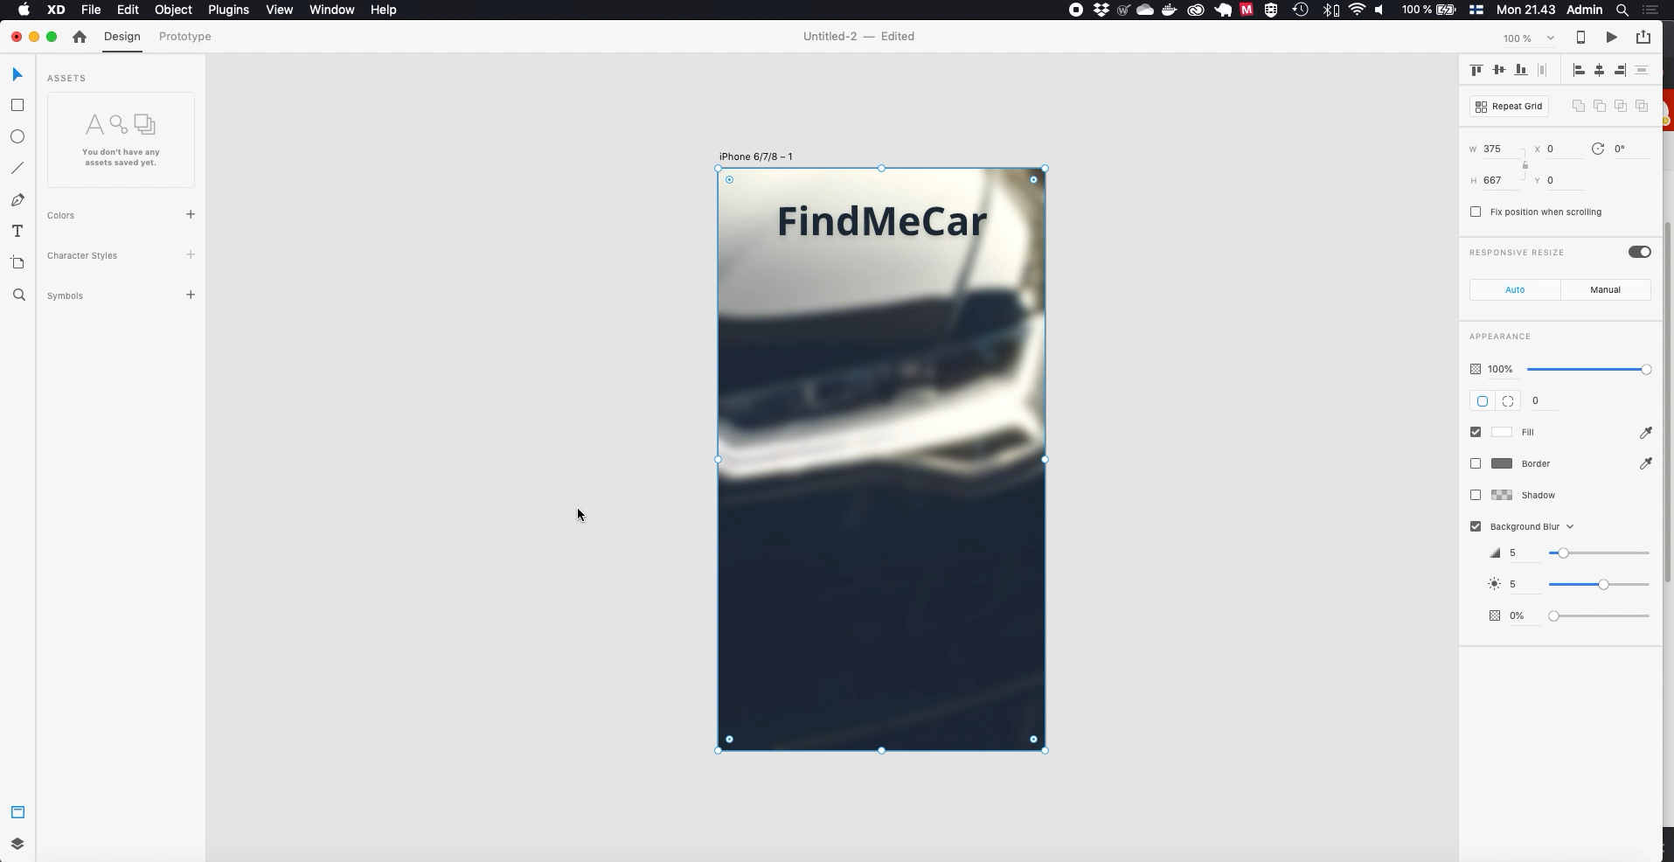

Slide 15
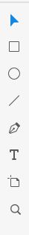
Adding vector objects
In Adobe XD there are four ways to draw vector objects
Rectangle
Circle
Line
Free form
These object have same properies (mostly), in this tutorial we use rectangle object as its most common.
Choose Rectangle tool for now
Rectangle
Circle
Line
Free form

Slide 16
Adding vector objects
To add rectangle object press and drag mouse on page design.
We are adding button for user, so let’s add it to the below of text area.
Then we make it’s fill color gray and disable border

Slide 17


Slide 18
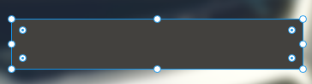
Modifying object
To add rectangle object press and drag mouse on page design.
We are adding button for user, so let’s add it to the below of text area.
Then we make it’s fill color gray and disable border
Drag points to size object
Round corners of object

